Slide 1
STUDENT MANAGEMENT SYSTEM
BY
K.VISHALI

Slide 2
ABSTRACT
The Student Management System application will help in managing the student’s report will be easier with the one system.
It will also help in saving time and effort.
If you want to get any information regarding the particular student then it can be obtained by just entering the roll number of the student to be searched.
This Student Management System will make the work of storing the data in an organized way.

Slide 3
SCOPE
Without a Student Management System, managing and maintaining the details of the student is a tedious job for any organization.
Student Management System will store all the details of the student such as roll number, name, grade level, courses enrolled and the tuition balance for each course.

Slide 4
MODULES
Insert Student Record .
Select Student Record.
Update Student Record.
Delete Student Record.
Exit.

Slide 5
INSERT STUDENT RECORD:
The insert method is used to inserting the student roll number, name, grade level,courses enrolled and the tuition balance of each course.

Slide 6
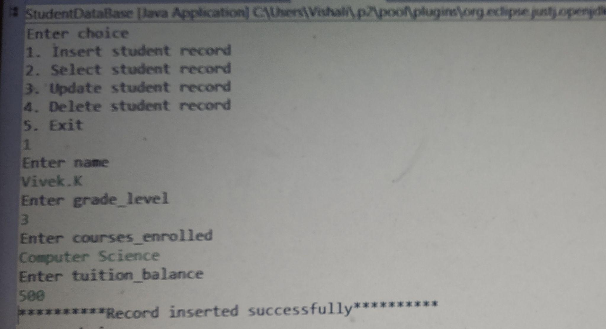
INSERT STUDENT REPORT SCREEN:

Slide 7
SELECT STUDENT RECORD:
The select method is used to select the information of a particular student by entering student roll number.
By inserting the roll number the student can view his/her details of grade level, courses enrolled and tuition balance.

Slide 8
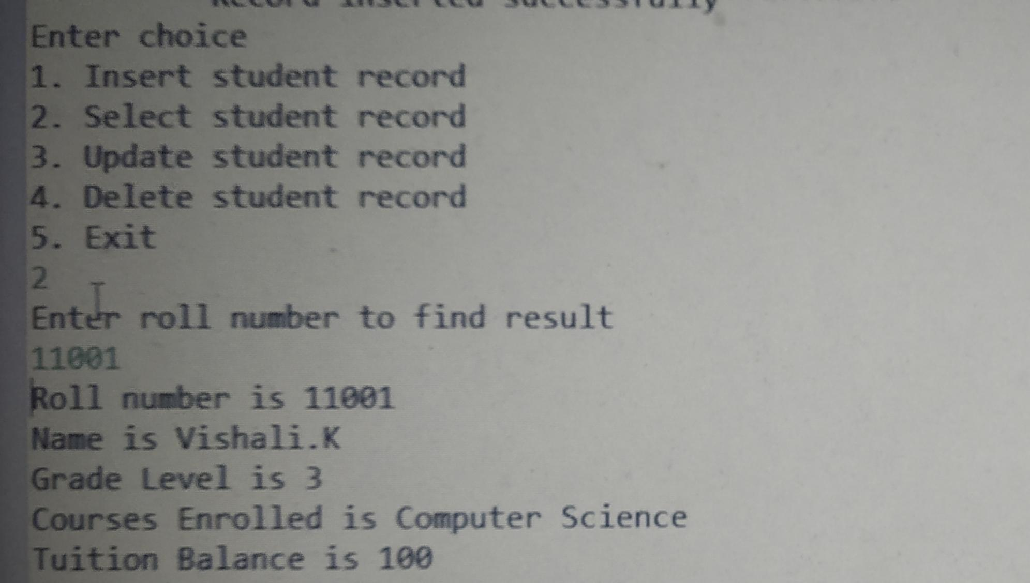
SELECT STUDENT RECORD SCREEN:

Slide 9
UPDATE STUDENT RECORD :
The Update Record is used for updating the student’s name, grade level, courses enrolled and tuition balance if we want to update.

Slide 10
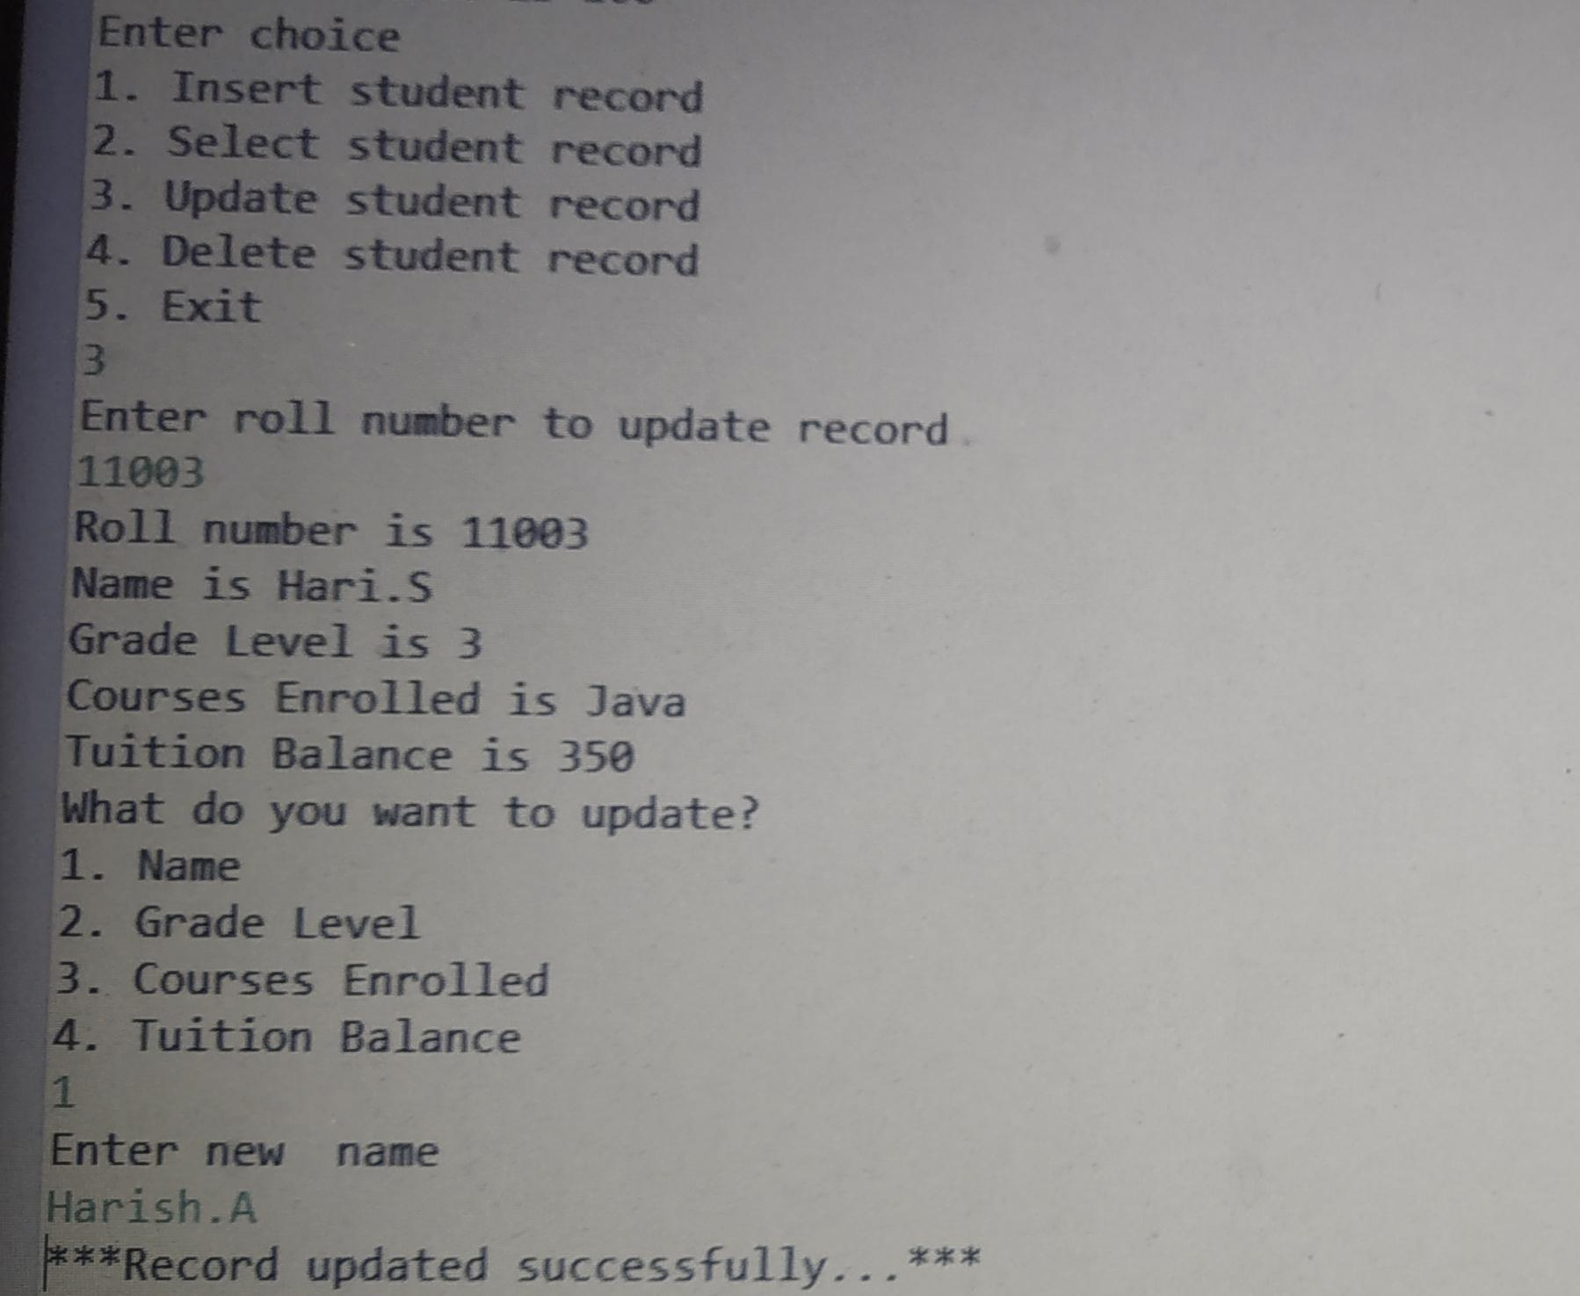
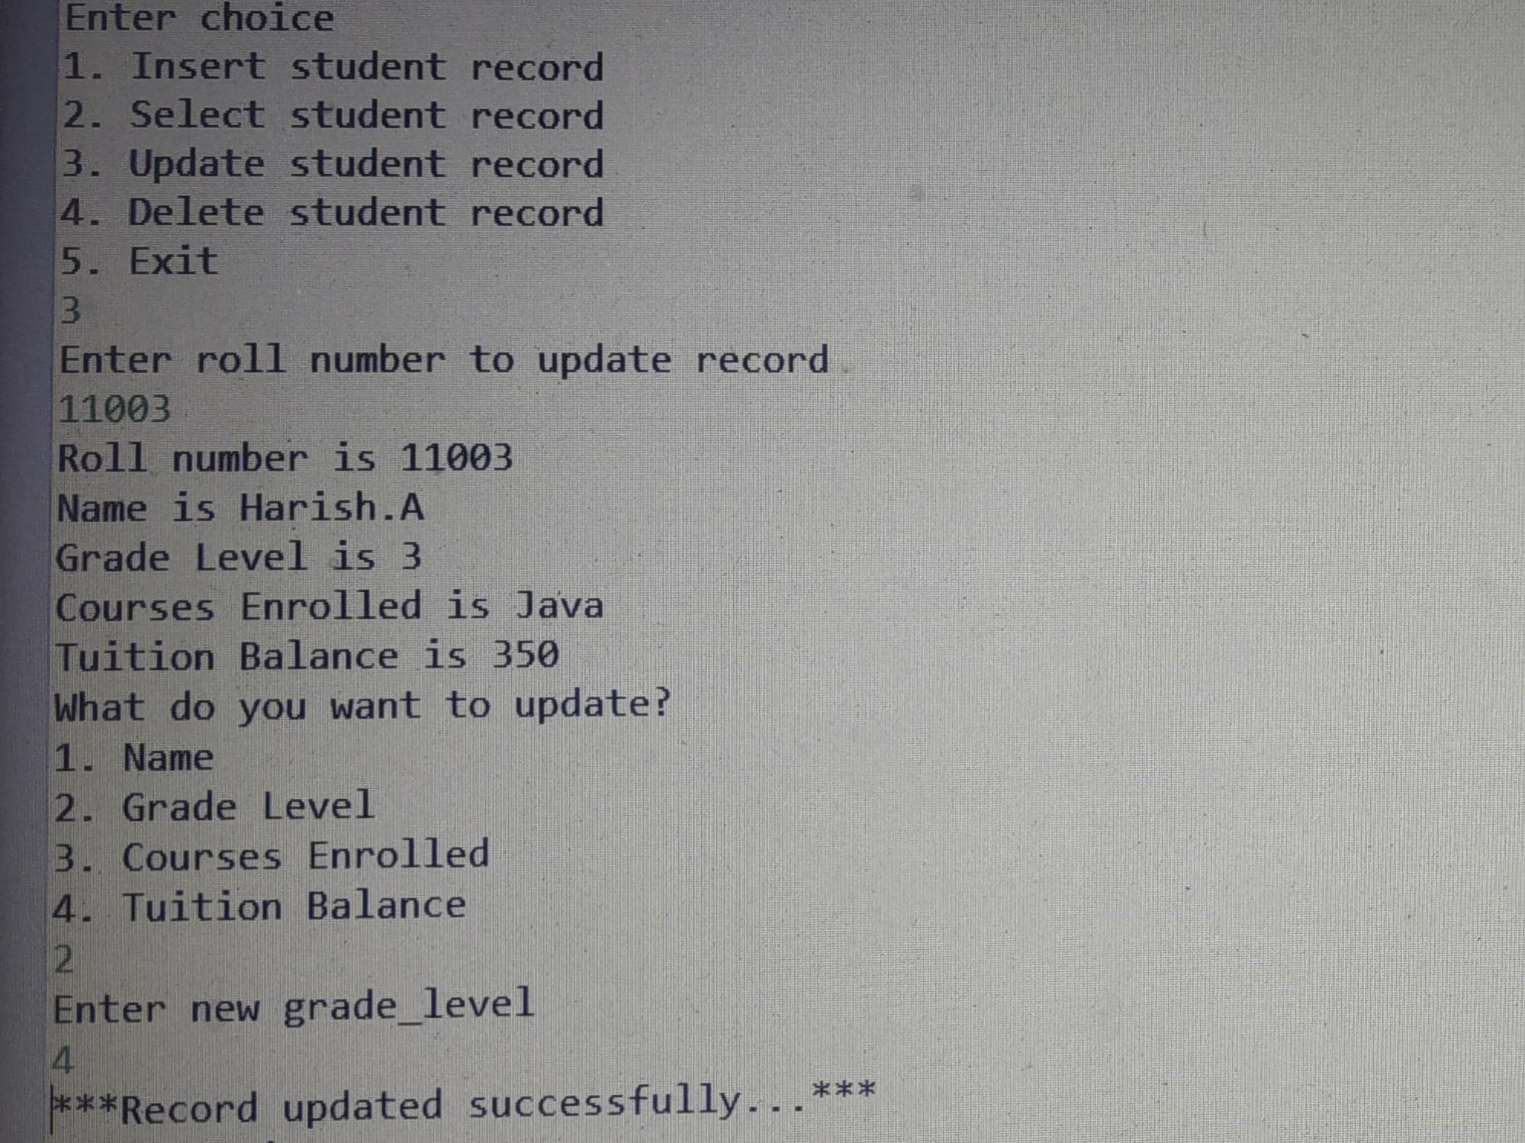
UPDATE STUDENT REPORT SCREEN 1:
NAME: GRADE LEVEL:

Slide 11
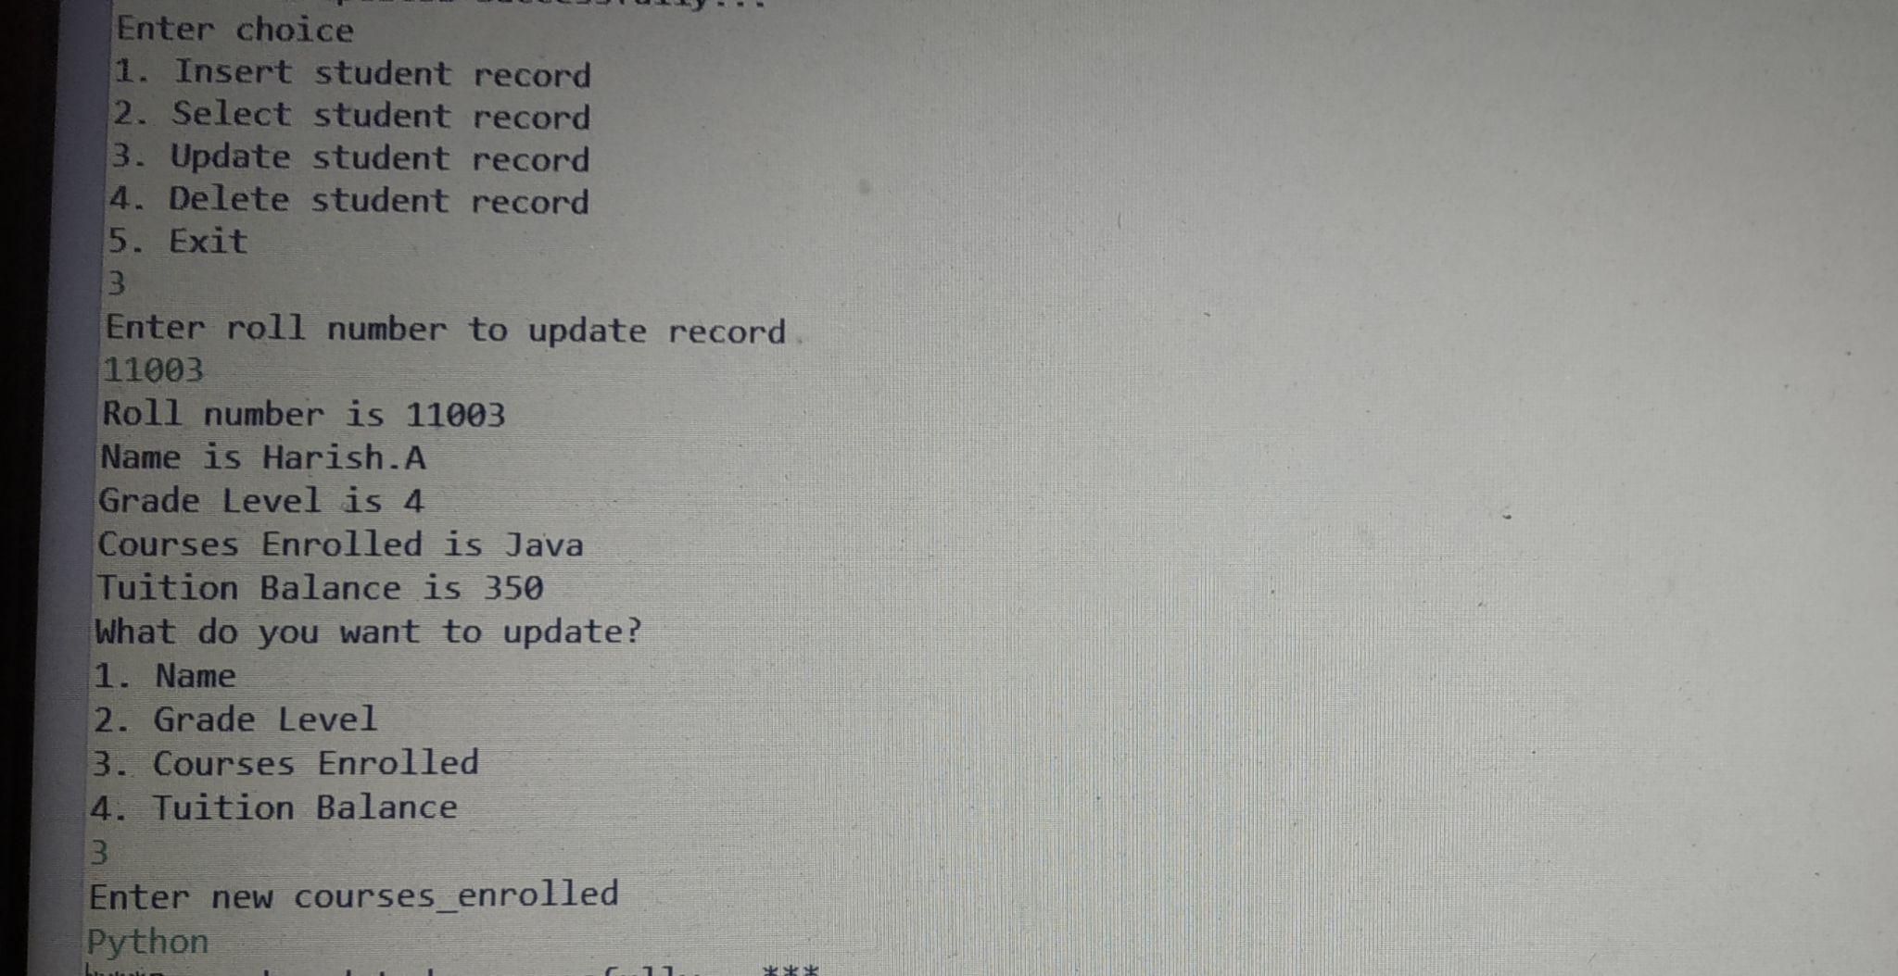
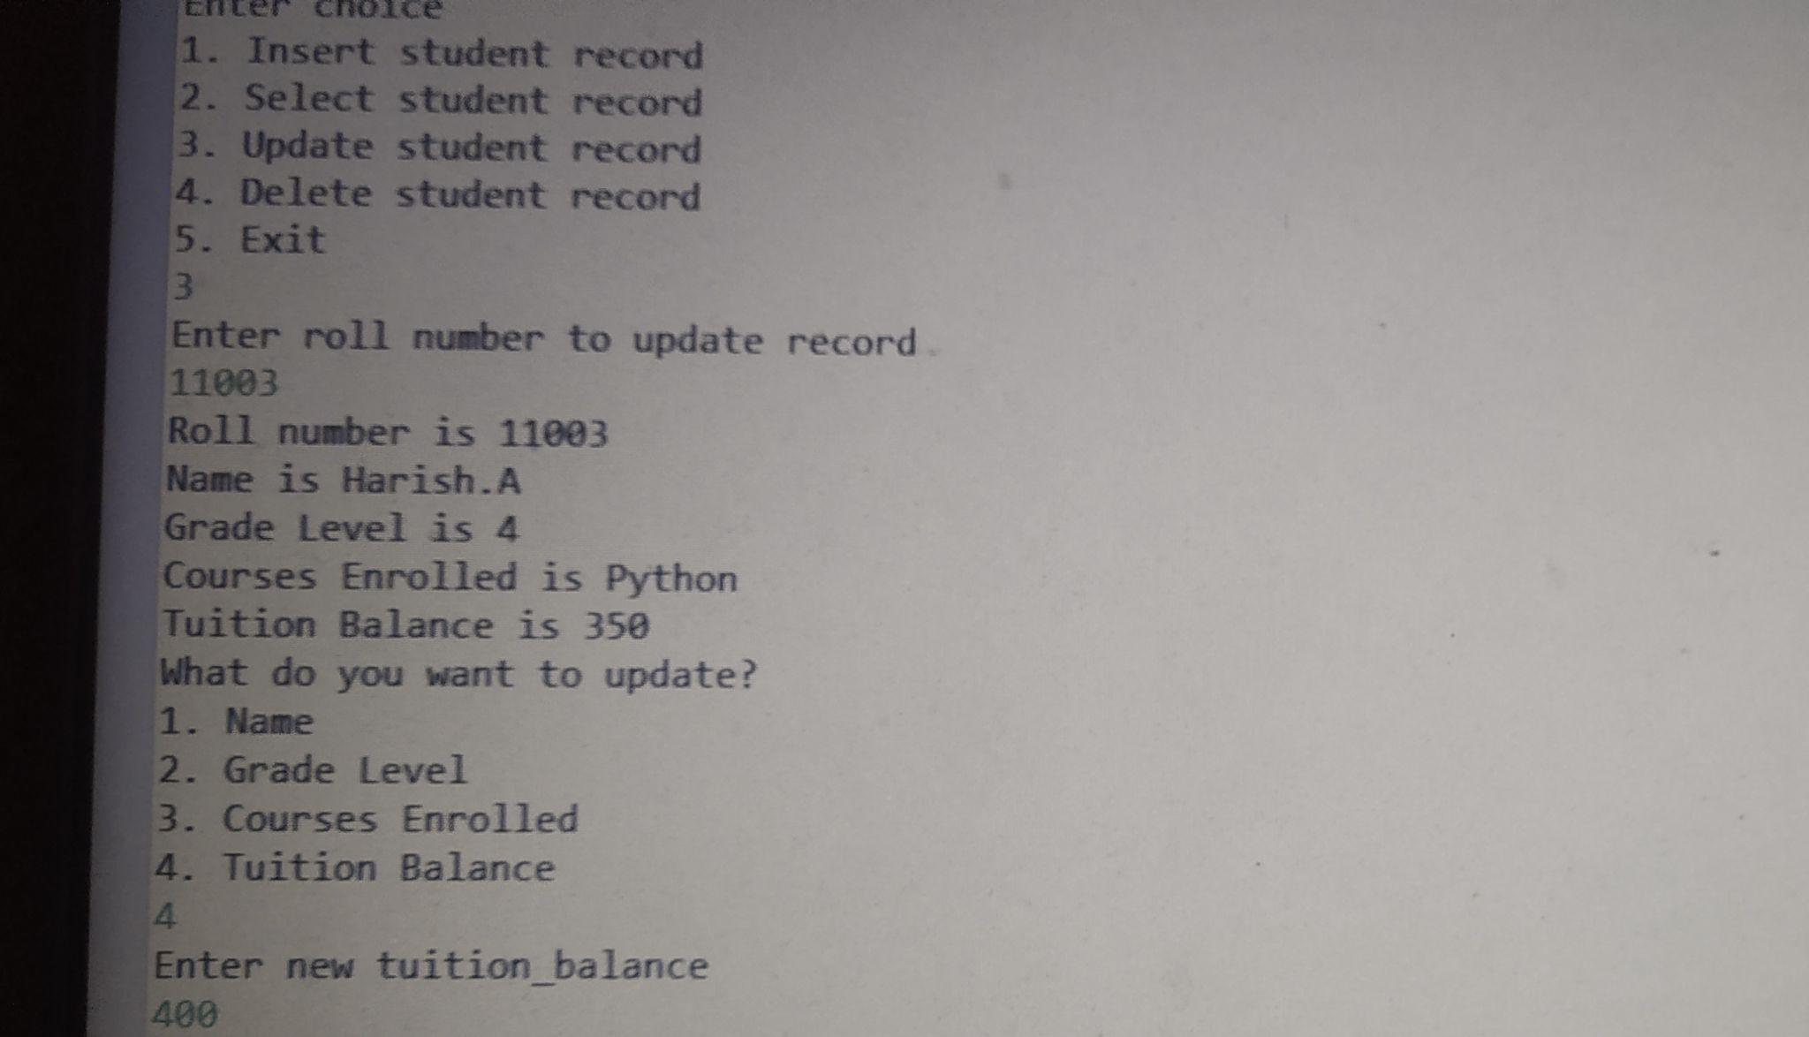
UPDATE STUDENT RECORD SCREEN 2:
COURSES ENROLLED: TUITION BALANCE:

Slide 12
DELETE STUDENT RECORD:
The Delete Record is used to delete the details of the student record.
By entering the roll number we can delete the particular record of the student if needed.

Slide 13
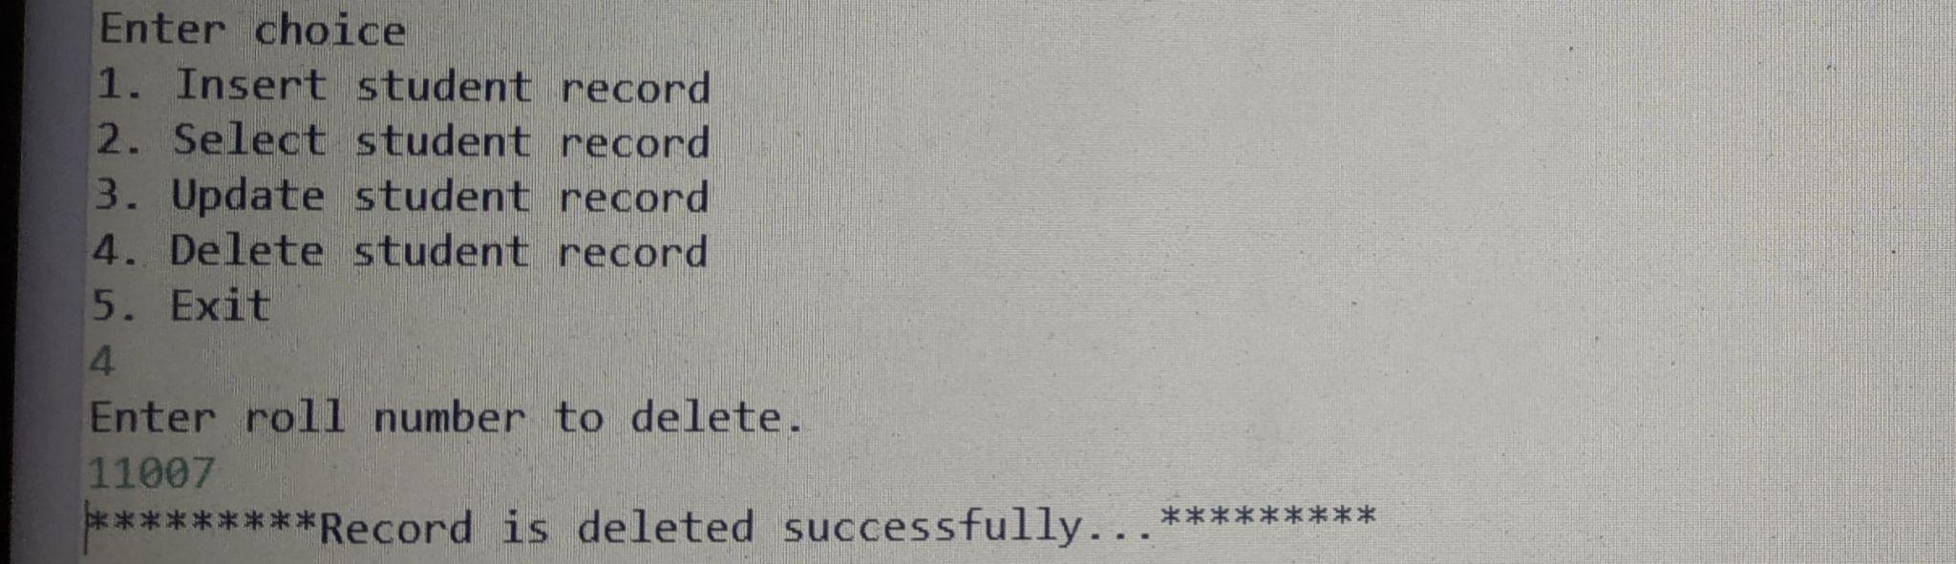
DELETE STUDENT RECORD SCREEN:

Slide 14
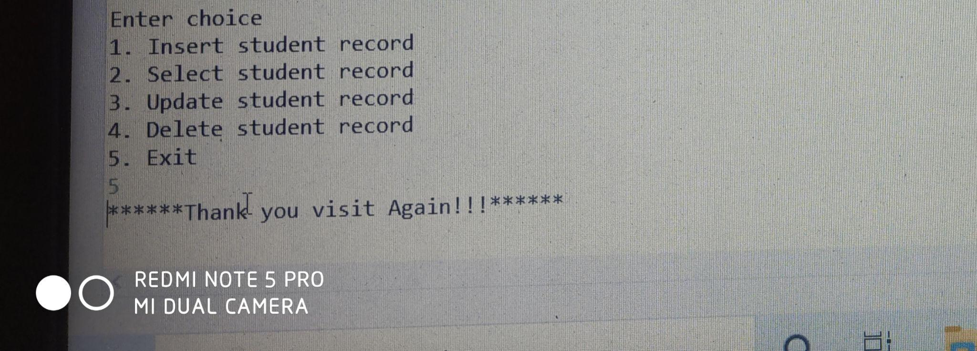
EXIT :
The exit is used to exit the page.

Slide 15
ADVANTAGES
Eco-friendly: paperwork can be avoided.
Easier to access.
Can get the information of the particular student within a few seconds.
Can delete the records of the particular student.
Single solution for the total Student management System.
Can update the student records if necessary.
Supervise multiple branches.
Cost efficient and User-friendly.
Efficient control over student data.
Monitor student performance.

Slide 16
CONCLUSION:
Student Management System can be used by the administrators to maintain the student records.
By achieving this objective, the student can see the details by entering his/her roll number, name, grade level, courses enrolled and tuition balance.
This project is useful for the administrators to maintain the student’s records easily.

Slide 17
THANK YOU

